Slide 1
Face Recognition with KNN in MATLAB

Slide 2
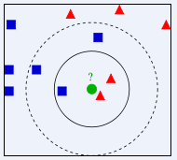

Slide 3
